Slide 1




GROCERY BILL
MANAGEMENT
SYSTEM

Slide 2





INTRODUCTION
Objective:
Automate the billing process in retail stores.
Provide a simple and user-friendly interface for handling customer information and generating detailed bills.
Significance:
Reduces manual errors in billing.
Saves time by automating calculations and tax computation.
Offers an organized way to manage sales transactions.
Technologies Used:
Programming Language: Python.
GUI Library: Tkinter for creating the graphical interface.

Slide 3


FEATURES
Customer Information Management:
Captures customer name, phone number, and assigns unique bill numbers.
Product Categorization:
Items are divided into categories: cosmetics, groceries, and others, each with predefined prices.
Automated Calculations:
Automatically computes totals and taxes based on selected items and quantities.
Bill Generation:
Produces a detailed bill including customer details, purchased items, quantities, and prices.
User-Friendly Interface:
Easy-to-navigate interface with sections for data entry, product selection, and bill display.

Slide 4

TECHNOLOGIES USED
Main Components:
Bill App class: Encapsulates all core functionality.
Functions for handling data input, calculations, and output.
Workflow Overview:
Input: User enters customer details and selects products.
Processing:
Totals are calculated.
Taxes are added dynamically for each category.
Output: A detailed bill is generated and displayed in the bill area.
Frontend (UI): Designed with Tkinter using frames, labels, entry fields, and buttons for interactivity.

Slide 5
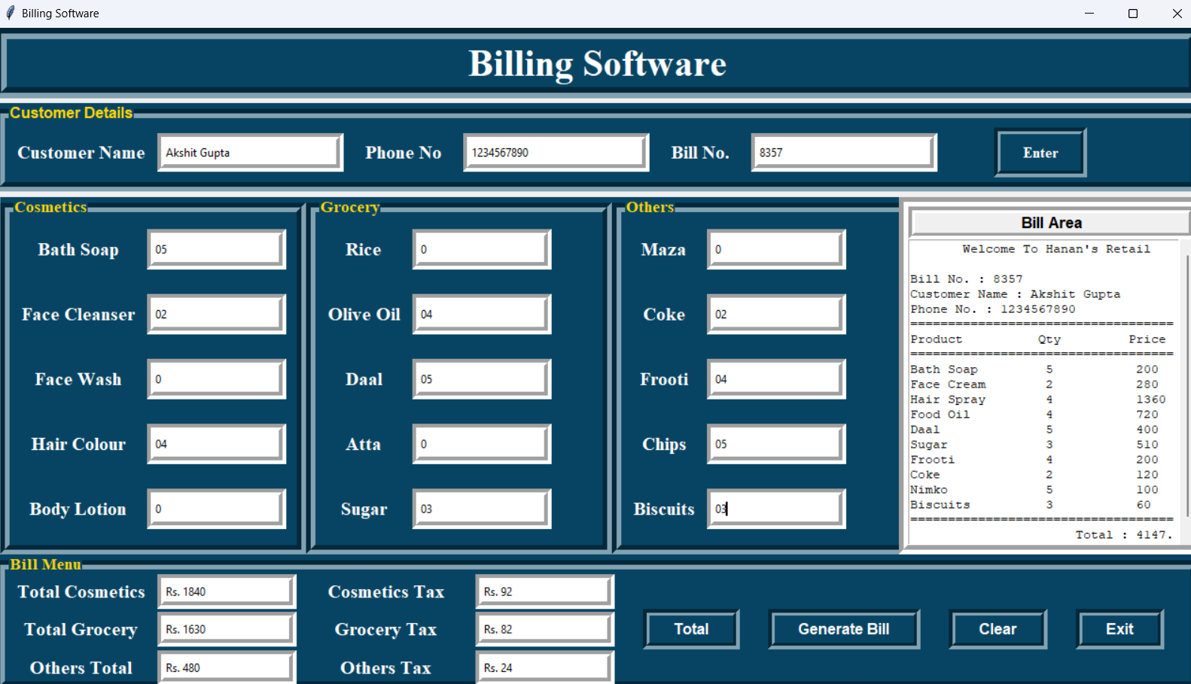
FRONTEND

Slide 6

CONCLUSION
The Grocery Bill Management System provides a comprehensive solution for automating billing in retail environments. Reduces manual errors and enhances efficiency with an intuitive interface.
Learnings:
Improved problem-solving skills through modular design and implementation.
Enhanced knowledge of Python, Tkinter, and GUI development.
Learned debugging techniques to ensure accurate calculations and a responsive UI.
Future Enhancements:
Adding database support for storing customer and transaction data.
Integrating advanced features like digital payment options and inventory tracking

Slide 7

INGOUDE
COMPANY
THANK
YOU

